Slide 1

MSBA 250 - Applied Business Analytics
Spring 2024
Urban Bliss Index
Insights from the City Happiness Index
Unraveling the Factors that Shape Cities Well-being
Group Members:
Shabana Gul
Sushmith Naik Banoth
Priya Shrotri
Eshma Cherukuri
Sirivanth Sai Bandreddi
Phuc Minh Thao Pham
Notes:
Why did we choose this topic?

Slide 2


Table of Contents
Introduction & Objective
Overview of the Dataset
Method
Results
Managerial Implication
Data Analysis
Conclusion

Slide 3
Weekly Schedule of Project Progress
Week Start | Week End | Planned Progress
29-Jan | 4-Feb | Topic Research
5-Feb | 11-Feb | Topic Selection & Assignment of Tasks
12-Feb | 18-Feb | Research Methodology Selection & Project Proposal Creation
19-Feb | 25-Feb | Data Cleaning & Manipulation
26-Feb | 3-Mar | Data Cleaning & Pipeline Creation
4-Mar | 10-Mar | Data Modelling & Regression Analysis
11-Mar | 17-Mar | Data Visualisation & Inference
18-Mar | 24-Mar | Project Review and Auditing
25-Mar | 31-Mar | Research Report Writing
3-Apr | 12-Apr | Research Report Writing
12-Apr | 20-Apr | Final Review & Edit

Slide 4
Introduction & Objective
Welcome to the presentation on the ‘Urban Bliss Index’, which means City Happiness Index.
Curated by Emirhan BULUT, this dataset analyzes factors influencing overall happiness in global cities.
The dataset aims to provide insights into urban living conditions and population satisfaction.
.
What factors influence overall happiness and life satisfaction among urban residents?
By exploring this investigation reveals the complexities of urban living conditions, social interactions, and environmental elements that influence the satisfaction and happiness levels of the population.
Notes:
Urban happiness crucial for quality of life in cities.
Insights help policymakers and researchers make informed decisions.
Understanding factors that shape happiness enhances urban well-being.

Slide 5
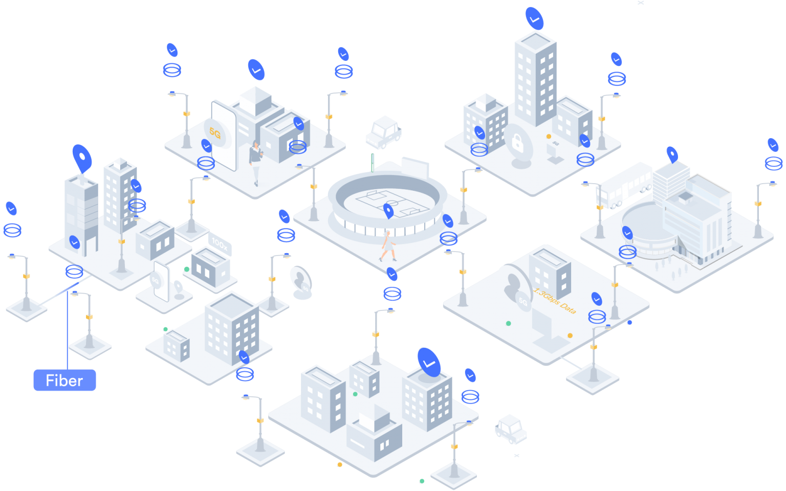
Objective of the Study
Urban happiness crucial for quality of life in cities.
Insights help policymakers and researchers make informed decisions.
Understanding factors that shape happiness enhances urban well-being.

Slide 6
Overview of the Dataset
City Happiness Dataset
Examines global urban well-being
Factors: noise, traffic, green spaces, air, cost, healthcare
Influences overall happiness score
Applications
Researchers: Unravel urban dynamics
Policymakers: Enhance city life quality

Slide 7

Dataset's Key Characteristics
City Name, Month, and Year When Recorded
Noise Levels for Comfortable Hearing
Categories for Traffic Density
Amount of Green Space
Air Quality Rating
Level of Happiness
Cost of Living
Quality of Healthcare

Slide 8
The PIYAAI_2 Deep Q-Network Model
The "PIYAAI_2 Deep Q-Network Model" is a smart computer system.
It learns from experiences and tries to make good decisions.
It understands how happy cities are and predicts what might happen in the future, even if things change.
Notes:
PIYAAI_2 is an advanced Deep Q-Network model utilizing Reinforcement Learning, continuously improving its predictive abilities by learning from a specific dataset. This model holds potential for accurate predictions of future urban scenarios, adapting over time with new data to understand the factors influencing urban well-being and happiness.

Slide 9
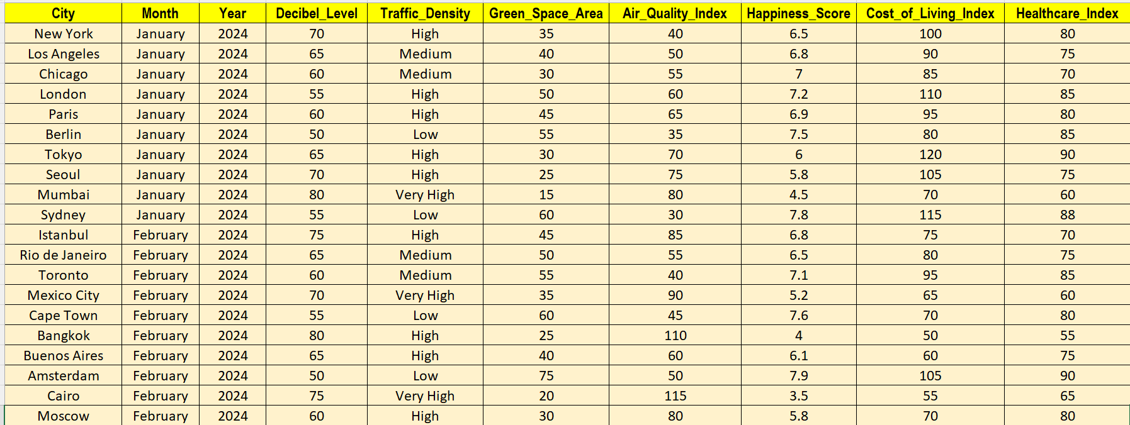
Dataset

Slide 10
Methodology
Data Collection
Data Compilation
Data Cleaning and Standardization
Variable Selection
Data Analysis
The City Happiness Index might have been created using software such as statistical tools:
Statistical Software: SPSS, R
Data Visualization Tools: Tableau, Power BI
Programming Languages: Python
Geographic Information System (GIS) Software: ArcGIS, QGIS
Machine Learning Frameworks: TensorFlow, PyTorch, scikit-learn
Spreadsheet Software: Microsoft Excel, Google Sheets
Notes:
Data Collection: Relevant data points from various sources, government databases, academic studies, international organization’s report
Data Compilation: The collected data was compiled into a structured dataset, with each city representing a unique observation and each variable representing a distinct aspect of urban well-being.
Data Cleaning and Standardization: cleaning and standardization procedures to ensure data consistency and reliability across different sources. Missing values were imputed, outliers were identified and addressed, and variables were standardized where necessary.
Variable Selection: Key variables were selected based on their relevance to urban well-being and availability in the collected datasets. Factors such as noise pollution levels, transportation infrastructure, access to green spaces, air quality, cost of living, and healthcare accessibility were essential for understanding urban happiness.
Data Analysis: Descriptive statistics, correlation analyses, and multivariate regression models were employed to analyze the relationships between variables and overall happiness scores. This included examining bivariate associations, identifying significant predictors of happiness, and exploring potential interaction effects

Slide 11
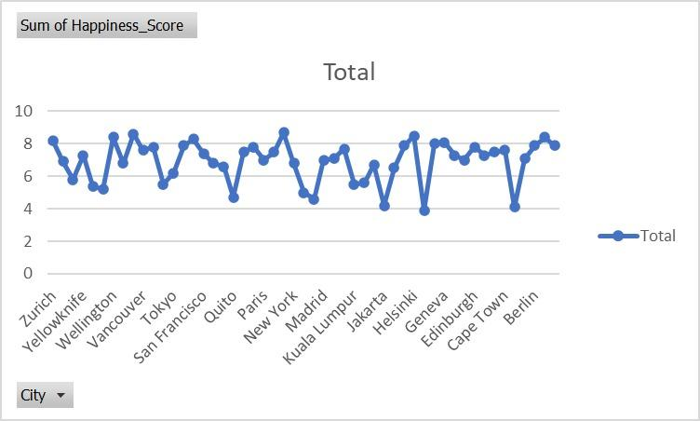
Data Visualization
Total Happiness Score by City

Slide 12
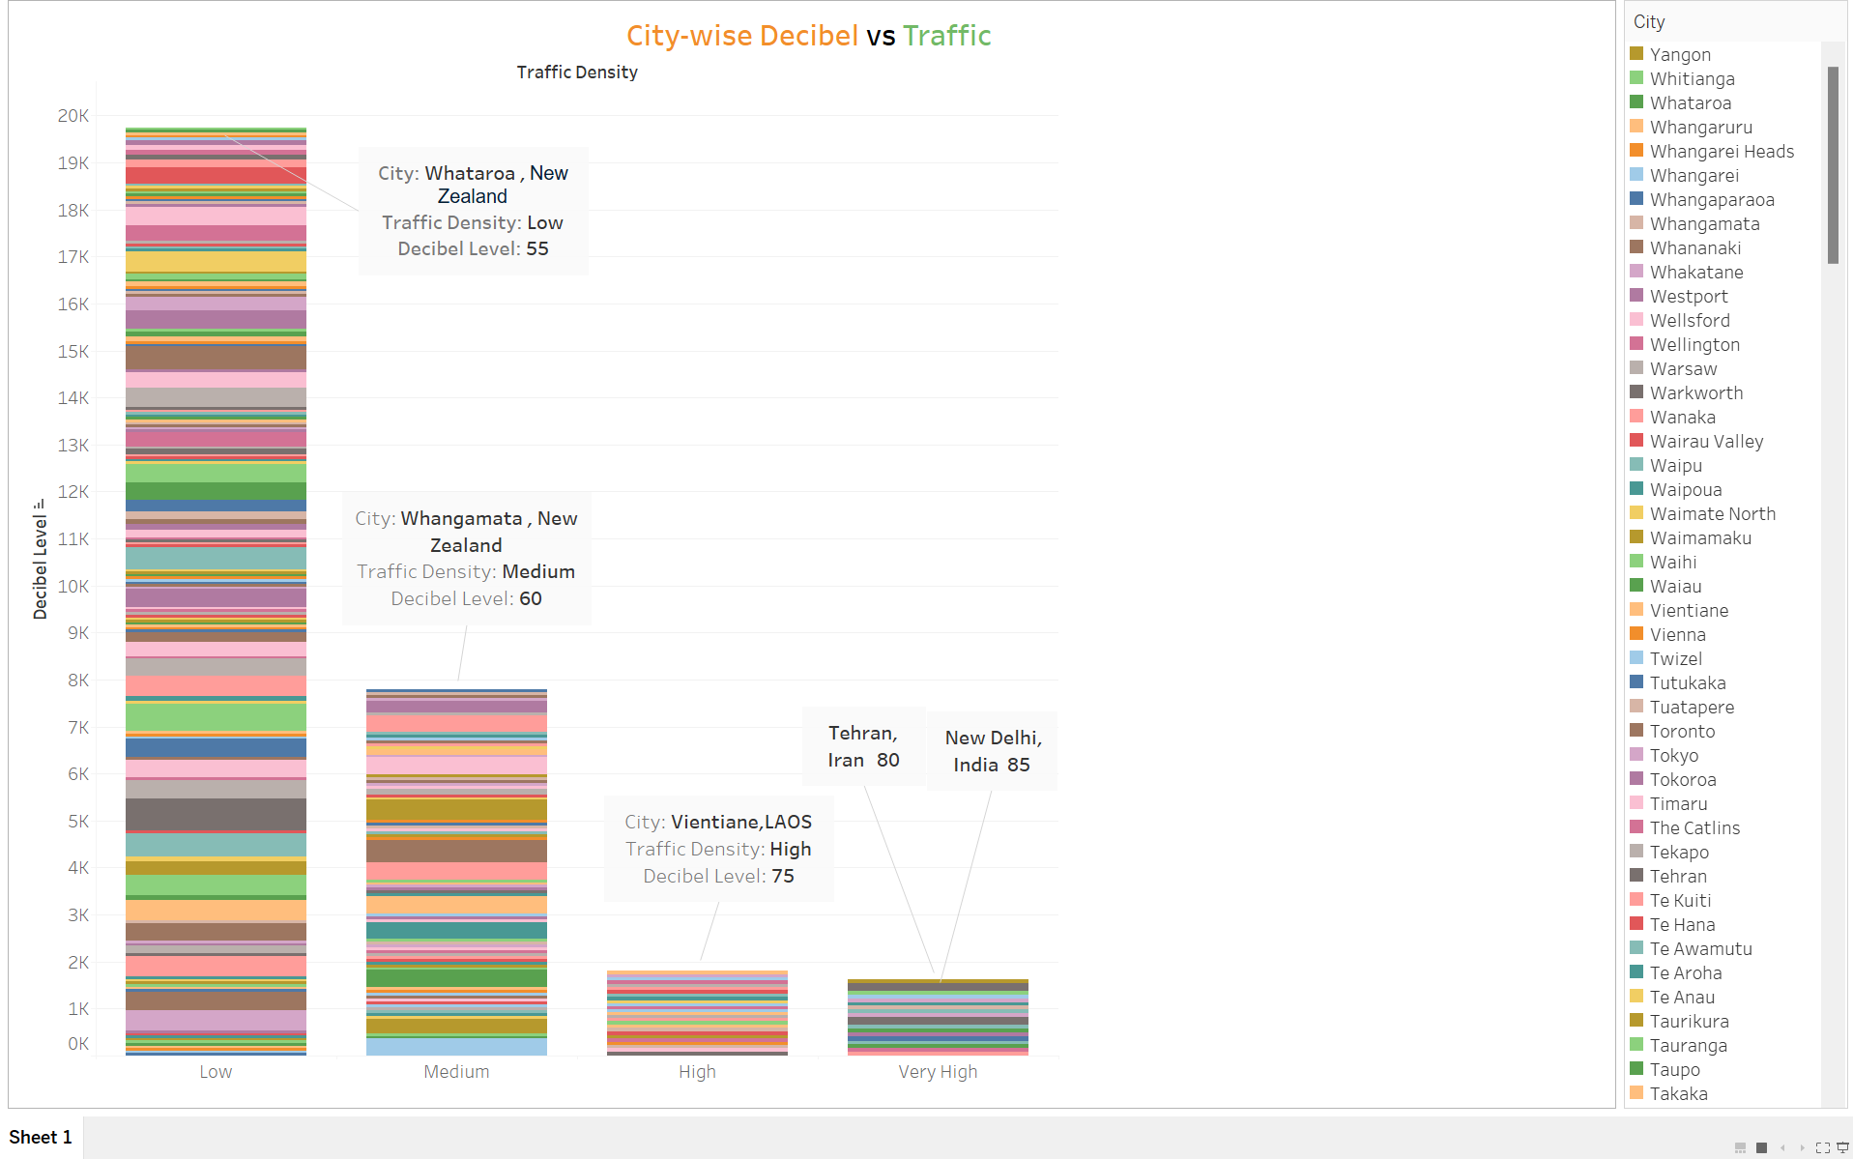
Scatter Plot
Densely populated areas with high traffic tend to have higher levels of sound decibels, potentially affecting the happiness index.
Notes:
In this chart, each data point represents a different city. It appears that areas with high traffic also have high levels of sound decibels, indicating densely populated regions. However, these densely crowded areas may not have a high happiness index.

Slide 13
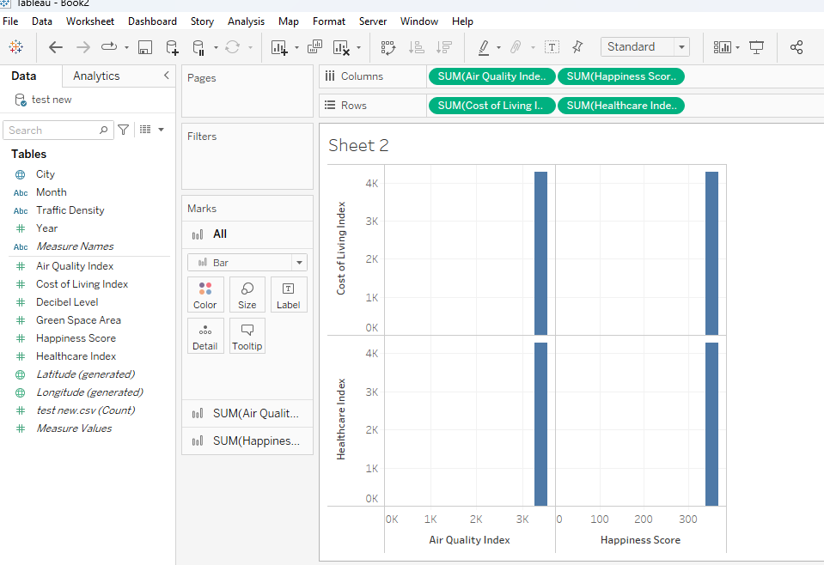
Data Visualization
Notes:
@esham, can you write the interpretation, or else just tell what did you understand by this chart.

Slide 14
Results
Positive correlation between Green Spaces and Happiness Scores
Influence of Noise Pollution on Happiness levels
Traffic Density and Commuting Stress
Air Quality and Life Satisfaction
Socioeconomic Factors and Happiness

Slide 15
Managerial Implications - Discussion
Urban Planning Interventions
Transportation Policies
Healthcare Provision Strategies
Socioeconomic
Notes:
4 Implications that can help manager improve the operations process and performance
Urban Planning Interventions: Policymakers and urban planners can use the insights from this dataset to design cities that prioritize green spaces, minimize noise pollution, and improve air quality, enhancing residents' overall happiness and well-being.
Transportation Policies: Efforts to reduce traffic congestion and improve public transportation infrastructure can increase urban happiness by reducing commuting stress and enhancing mobility.
Healthcare Provision Strategies: By addressing healthcare access and affordability disparities, policymakers can promote equitable healthcare provision, improve public health outcomes, and increase life satisfaction.
Socioeconomic—Development Initiatives: Implementing focused actions to lower living expenses and enhance economic prospects can ease financial burdens and improve residents' financial wellness, ultimately contributing to higher levels of overall happiness.

Slide 16
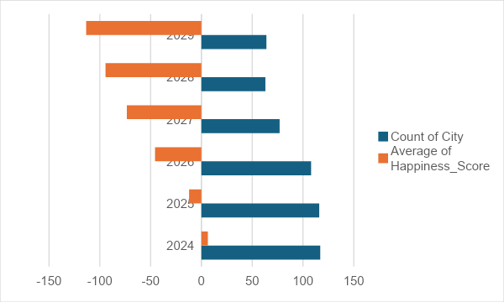
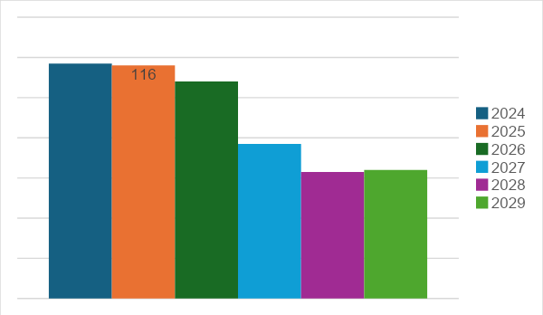
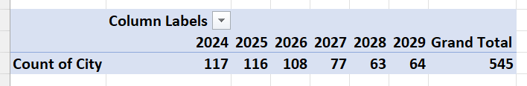
Additional Charts and Graphs

Slide 17
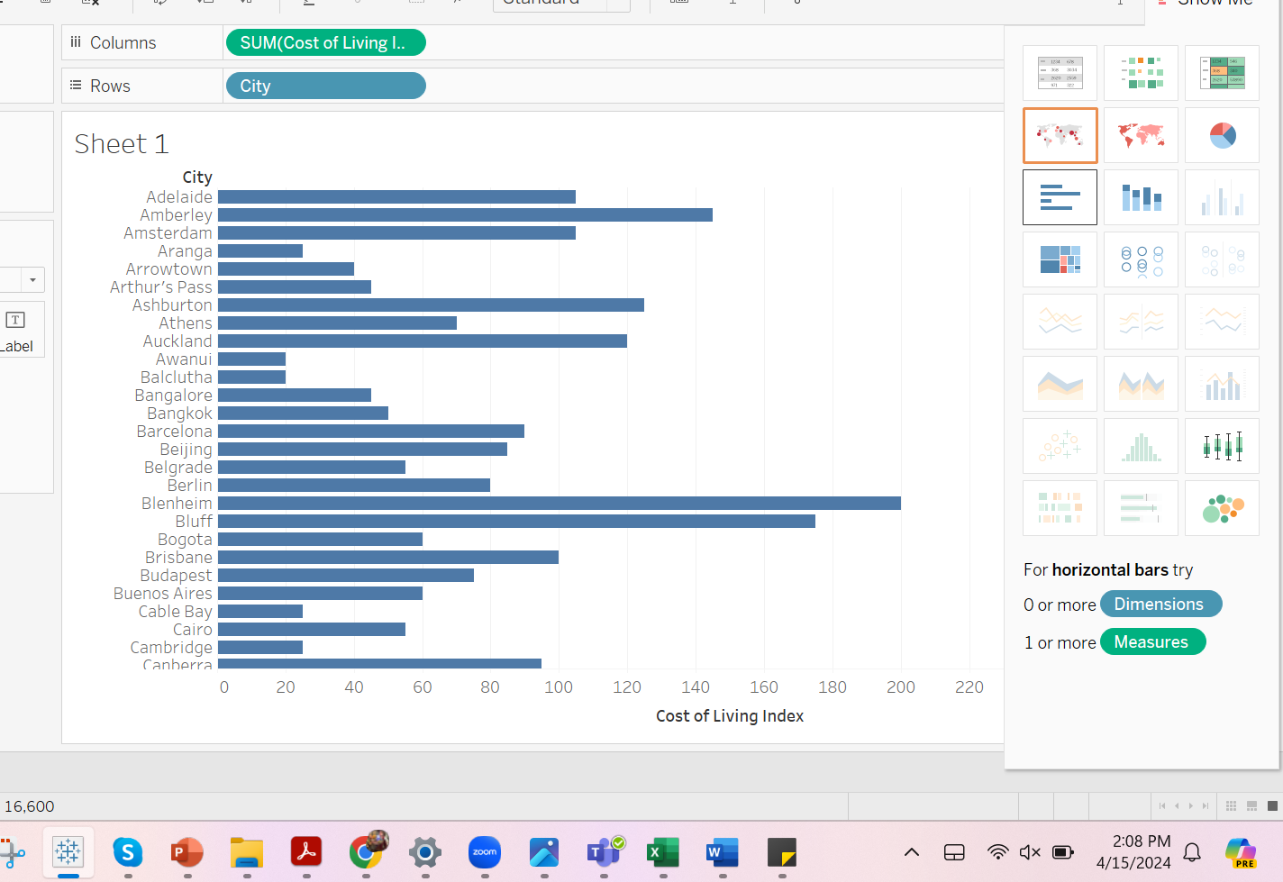
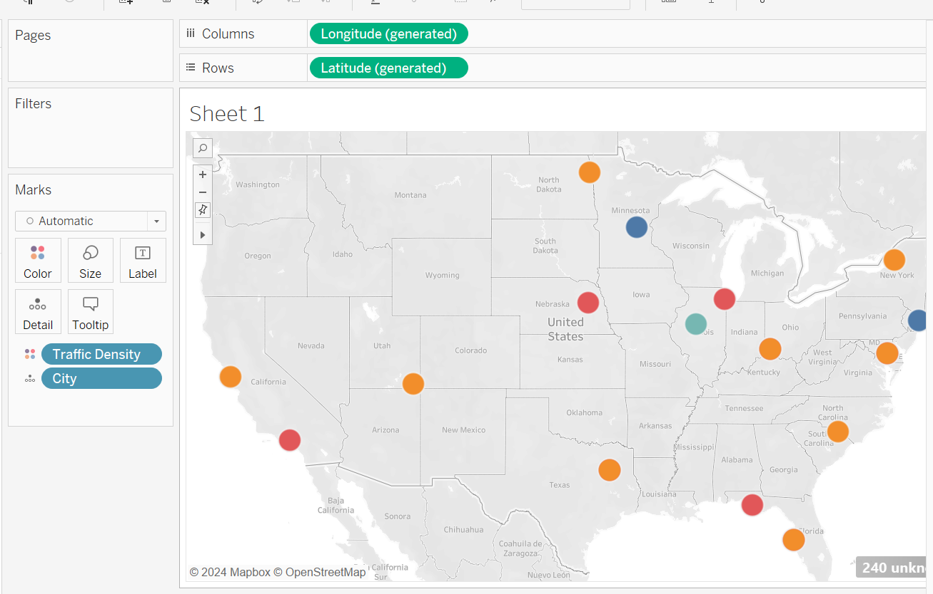
Additional Charts and Graphs
Cost of Living by City
Traffic Density in Different Cities

Slide 18
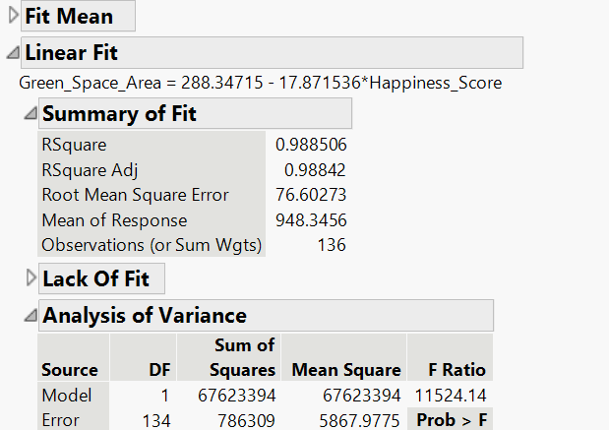
Linear Regression
Observation: A sample size of 136 is solid for analysis.
Regression Analysis: Regression models evaluate influence of independent variables on happiness.
Factor Analysis: Factor analysis delves into underlying factors affecting urban well-being.
Notes:
Descriptive Statistics:
Happiness_Score: The negative mean suggests low average happiness scores, with considerable city variability.
Green_Space_Area: On average, cities have almost 948 hectares of green space, but there's variability across cities.
Model Performance:
RSquare and RSquare Adj: Both are very high, indicating explanatory solid power even after adjusting for the number of predictors.
RMSE: The low value suggests accurate predictions with an average error of approximately 76.60 units.
Mean of Response: Provides context for the dependent variable's scale.

Slide 19
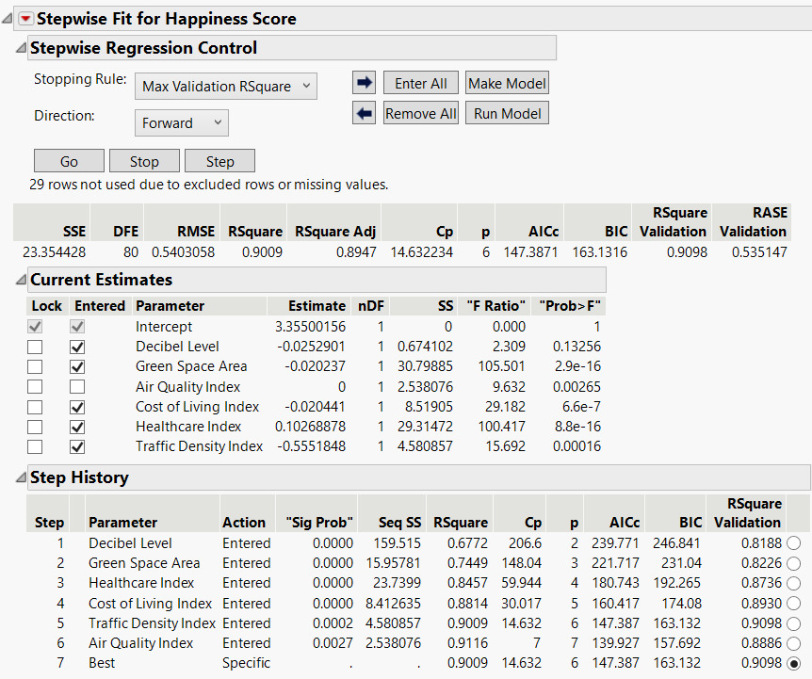
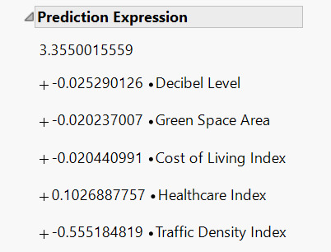
Stepwise Regression
Most impactful variable: Healthcare Index
Least impactful variable: Air Quality Index

Slide 20

Conclusion
City Happiness Index: Vital for planners and policymakers
Insights into citizen well-being and urban quality of life
Guides resource allocation for improvement
Evaluates public services, environment, cost of living
Facilitates city-to-city comparison for progress
Shapes urban development plans and policies
Enhances overall livability and vibrancy

Slide 21
References
2024 Urban Bliss Index. (2024, January 22). Kaggle. https://www.kaggle.com/datasets/willianoliveiragibin/2024-urban-bliss-index
BULUT, E. (2024, January 22). City Happiness Index - 2024. Kaggle. Retrieved April 20, 2024, from https://www.kaggle.com/datasets/emirhanai/city-happiness-index-2024
Burkart, K. M., Ahmed, F. S., Watson, K. E., Hoffman, E. A., Burke, G. L., & Barr, R. G. (2010). Association between high density lipoproteins (HDL) cholesterol and CT percent emphysema. the MESA Lung Study. ATS Journals. https://doi.org/10.1164/ajrccm-conference.2010.181.1_meetingabstracts.a2878
Hutt, S. (2023, September 12). Briansclub Economic Analyses by Nation: Unveiling the Global Financial landscape | ecommerce Fastlane. eCommerce Fastlane. https://ecommercefastlane.com/briansclub-economic-analyses-by-nation-unveiling-the-global-financial-landscape/

Slide 22
References
MathWorks. (n.d.). Deep Q-Network (DQN) Agents - MATLAB & Simulink. Retrieved April 20, 2024, from https://www.mathworks.com/help/reinforcement-learning/ug/dqn-agents.html
Poutintsev, F. (2022, August 19). What Are The Pros & Cons Of Living In Panama City Fl? Honest Pros and Cons. https://honestproscons.com/pros-and-cons-of-living-in-panama-city-fl/
World Happiness Report up to 2023 | Spreadsheet download | Gigasheet. (n.d.). https://www.gigasheet.com/sample-data/world-happiness-report-up-to-2023
Jesadiya, B., Thorat, V., Choudhary, K., & Kuthe, S. (2023). Consumers' Awareness and Buying Behaviour for Edible Oils in Surendranagar City of Gujarat. International Journal of Education and Management Studies, 13(3), 292-296.
Fiercely Bold Blog | Live Fiercely Bold. (n.d.). Live Fiercely Bold. https://www.livefiercelybold.com/blog

Slide 23
THANK YOU

